Slide 1
P1604 RAPID – community productivity rate estimates from Lagrangian O₂/Ar measurements
Seaver Wang, Nicolas Cassar

Slide 2
Background and motivations
Lagrangian measurements present special opportunities for underway O₂/Ar-based measurements
Tracking diurnal cycle of photosynthesis and respiration in the mixed layer, can estimate mixed layer gross oxygen production (GOP)
Questions of interest:
Relationships between grazing, observed GOP rates?
How can diurnal behavior be related to characteristics of each site (nutrient limitation, mixing, etc…)?
Questions of export: NOP/GOP, NOP/POC…
Notes:
-following same water mass eliminates horizontal advection as an influencing factor

Slide 3
Surface ocean biological fluxes of O₂
O2 production
O2 consumption
Atmosphere
CO2
O2
Net Community
Production
(positive in this illustration)
-
=
Gross Primary
Production (GPP)
Community
Respiration
export
Metric of productivity, metabolic balance of surface ocean
NCP estimates the organic carbon production available for export

Slide 4
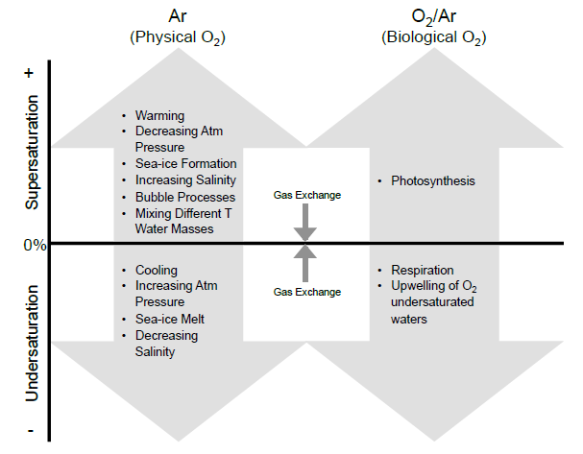
Surface ocean biological fluxes of O₂ – why dissolved O2/Ar?
Figure by Rachel Eveleth

Slide 5

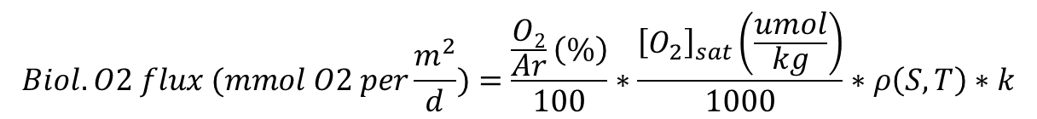
From O2/Ar to biological O₂ fluxes
$$Biol. O2 flux (mmol O2 per\frac{m^{2}}{d})=\frac{\frac{O2}{Ar}\left(\%\right)}{100}∗\frac{{\left[O_{2}\right]}_{sat}\left(\frac{umol}{kg}\right)}{1000}∗ρ\left(S,T\right)∗k$$
$\frac{O2}{Ar}\left(\%\right):$ % supersaturation of O2/Ar relative to air
ρ(S,T) : density of seawater (kg/m³)
k : piston velocity (m/d), weighted for wind speed history
${\left[O_{2}\right]}_{sat}$ : Oxygen concentration at saturation
Eqn 4, Cassar et al., 2011

Slide 6
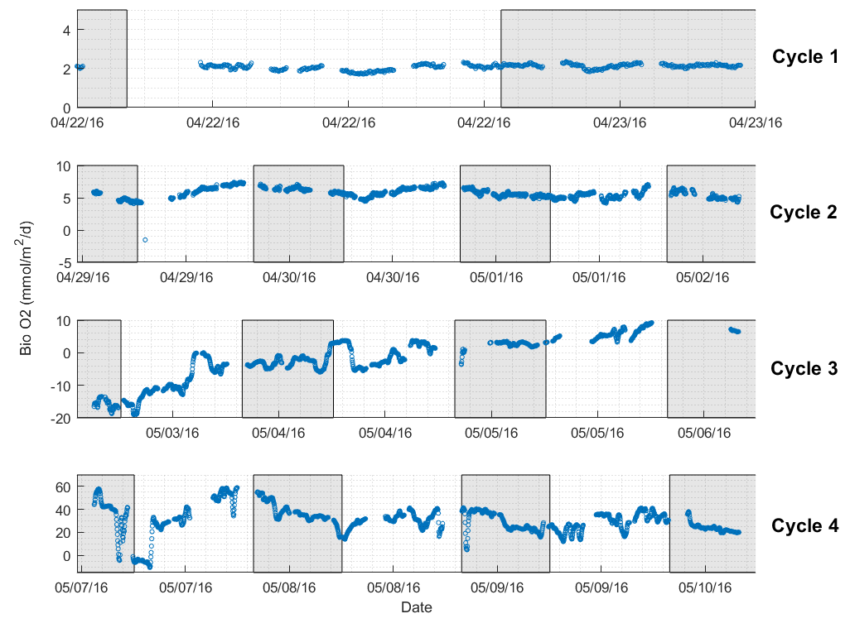
Lagrangian measurements
Cycle data filtered, excluding measurements collected >8km away from drift array
Cycle 1 – insufficient data
Cycle 3 – increase in biological oxygen saturation
De-trended using a linear fit

Slide 7
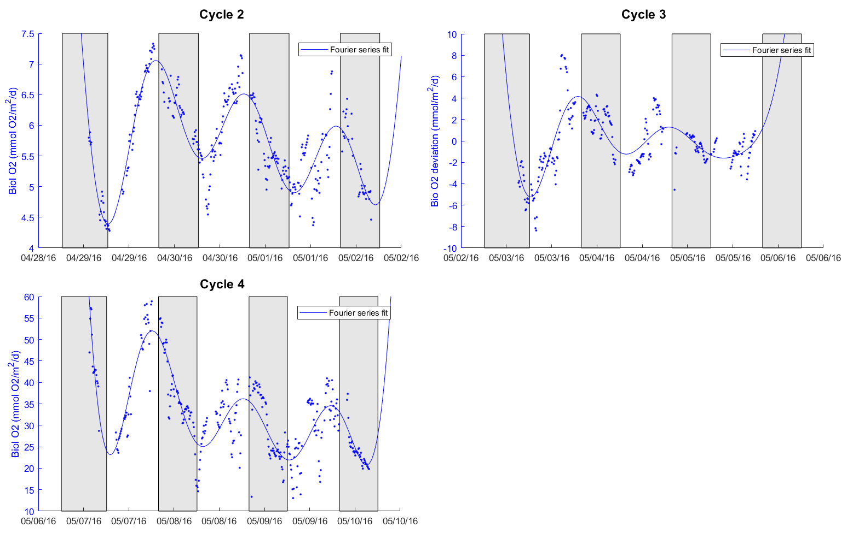
Cycles 2-4: curve fitting using a 4-term Fourier series

Slide 8
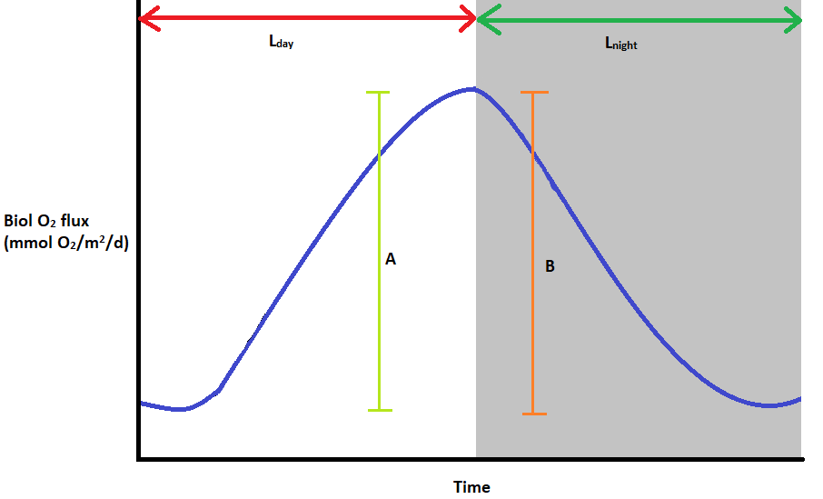
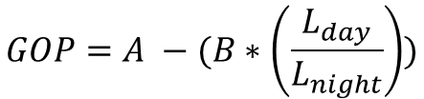
Gross Oxygen Production calculation
$$GOP=A −(B∗\left(\frac{L_{day}}{L_{night}}\right))$$
Simple calculation from fitted curve based on values of maxima at sunset, minima at dawn

Slide 9
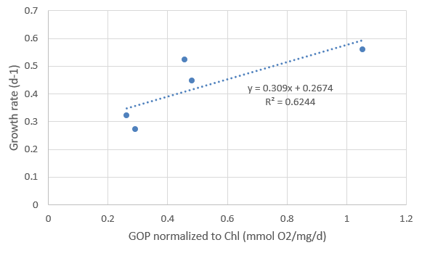
How are GOP/NOP related to growth/grazing from dilution experiments?
Fewer points for comparison than originally hoped for
Positive relationship between Chlorophyll-normalized GOP and intrinsic growth rate
No relationship between grazing rates and NOP/community respiration
 | Date | NOP (mmol O2/m^2/d) | CR (mmol O2/m^2/d) | GOP (mmol O2/m^2/d) | MLD (m) | Chl (ug/L) | Chl-normalized GOP (mmol O2/mg/d)
Cycle 2 D1 | 4/29/2016 | 2.66 | -1.59 | 4.71 | 65 | 0.15 | 0.58
Cycle 2 D2 | 4/30/2016 | 1.05 | -1.6 | 3.12 | 71.3 | 0.15 | 0.29
Cycle 2 D3 | 5/1/2016 | 1.06 | -1.41 | 2.89 | 73.7 | 0.15 | 0.26
Cycle 3 D1 | 5/3/2016 | 9.33 | -5.3 | 16.37 | 16 | 0.97 | 1.05
Cycle 3 D2 | 5/4/2016 | 2.39 | -4.01 | 7.73 | 17.6 | 0.96 | 0.45
Cycle 3 D3 | 5/5/2016 |  |  |  | 17.3
Cycle 4 D1 | 5/7/2016 | 27.13 | -26.94 | 63.43 | 18 | 4.53 | 0.78
Cycle 4 D2 | 5/8/2016 | 11.05 | -18.995 | 36.79 | 11.4 | 3.97 | 0.81
Cycle 4 D3 | 5/9/2016 | 12.66 | -12.44 | 29.52 | 12.2 | 4.34 | 0.56

Slide 10
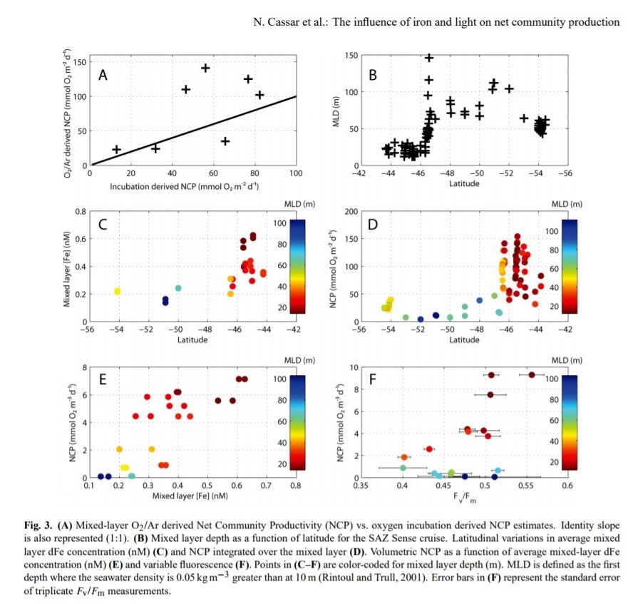
GOP vs Fv/Fm
Potentially informative regarding nutrient limitation and productivity
Cassar et al., 2011

Slide 11
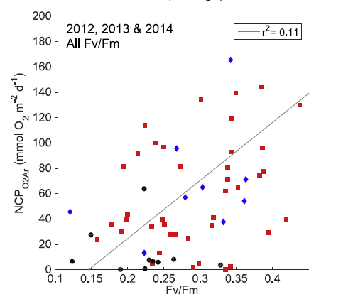
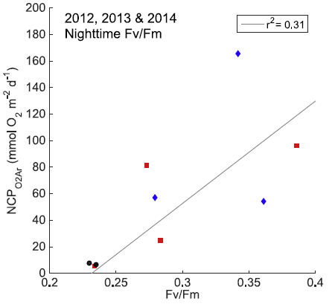
GOP vs Fv/Fm
Potentially informative regarding nutrient limitation and productivity
Eveleth et al., 2017

Slide 12
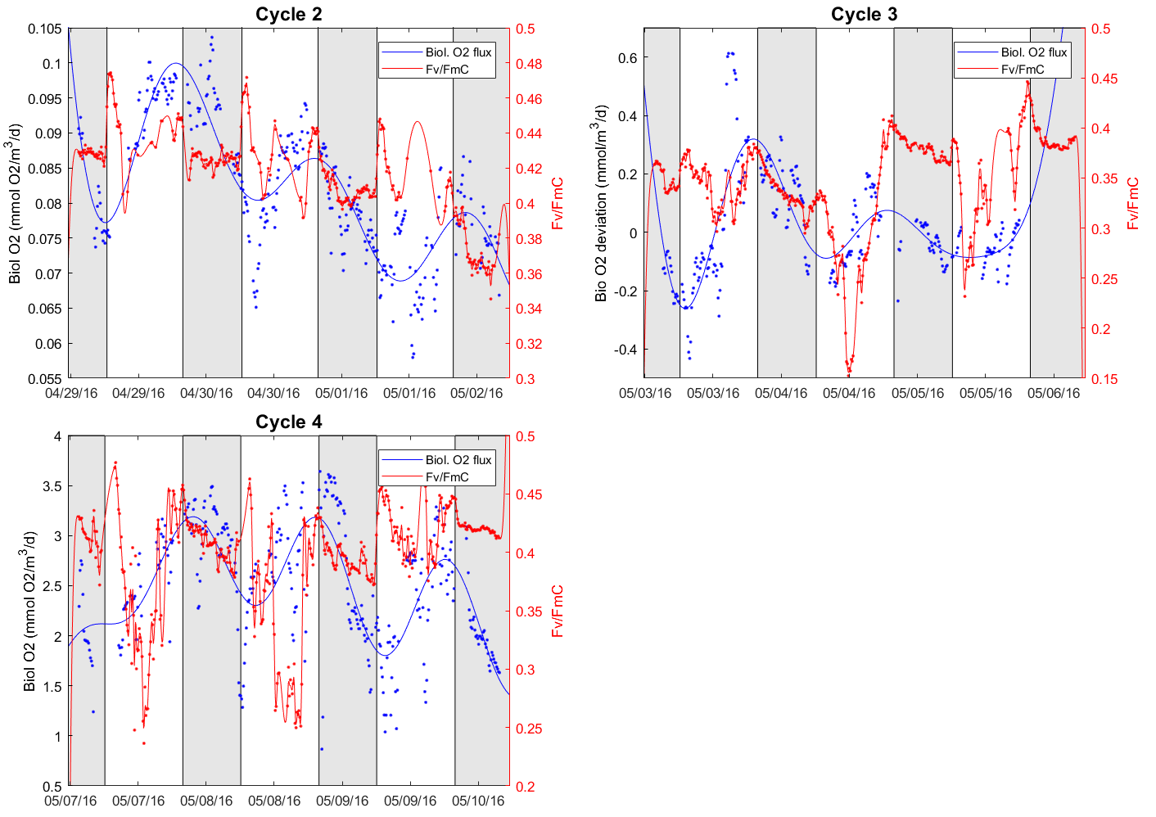
Fv/Fm measured concurrently while underway via ALF
Diurnal pattern to Fv/Fm measurements—Fv/Fm often lower, usually more variable during day

Slide 13
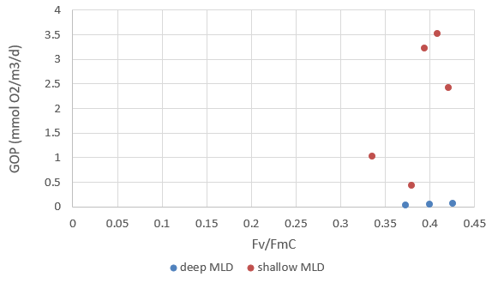
GOP vs Fv/Fm
Compared our productivity rates with mean nighttime Fv/Fm values
In our case, observe no trend with GOP or NOP
Likely due to narrow range of Fv/Fm values measured
deep: Shallow:
MLD >20m MLD <20m

Slide 14
Next Steps
Other comparisons: POC, exploring discrepancy with ¹⁴C…
Assessing/correcting contribution of vertical fluxes of O₂/Ar (entrainment, vertical eddy diffusion…)
Also interested in examining whether we reliably tracked the same water mass at each cycle
Suggestions welcome!

Slide 16
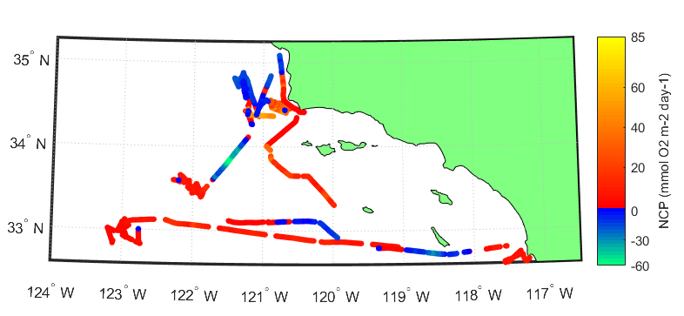
P1604 El Niño RAPID cruise
Biol O₂ flux (mmol O₂/m²/d)
O₂/Ar ratio in surface seawater continuously measured via EIMS throughout cruise
Here will focus on measurements conducted at each cycle location

Slide 17
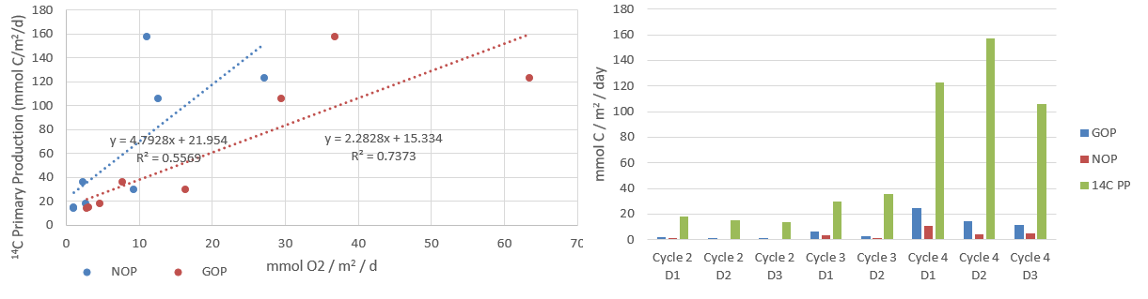
Comparison with ¹⁴C primary productivity
GOP/NOP values show an unexpected discrepancy with ¹⁴C-derived primary production rates
Right plot assumes conversion factor of 2.6 O₂ : 1 C for GOP
Looking at left side plot, usually other comparisons have found that O₂-derived gross production is substantially larger than ¹⁴C PP rates.
Contamination of biol. O₂ signal due to vertical fluxes a possibility, but the discrepancy here is very large

Slide 19
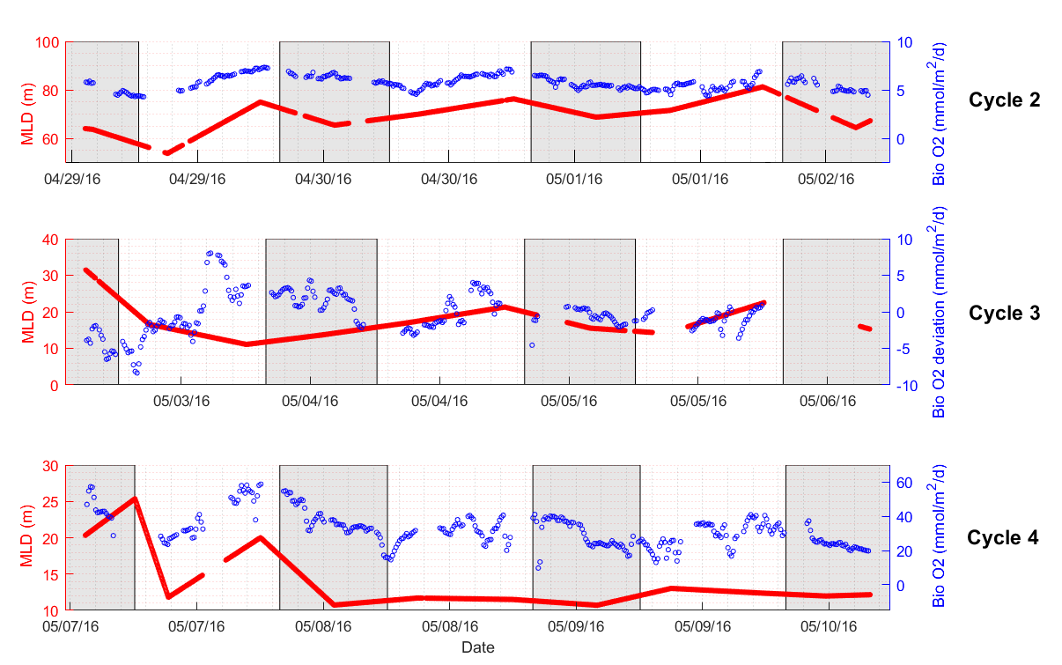

Slide 20
